Slide 1
Introduction to Computer Vision
Harish Kashyap: harish@pandita.ai

Slide 2

Harish Kashyap
An Entrepreneur, AI SME at MIT Horizon. Machine Learning, robotics, big data, Gen AI and signal processing
Over a decade of experience as a researcher across various industries, including Amazon Robotics, KLA Tencor and BBN Technologies
Career highlights include leading the development of AI-driven algorithms that interact with robotic systems
Founder of two companies: Mysuru Consulting Group(MCG) and Pandita AI
GitHub: https://github.com/harishkashyap
LinkedIn: https://www.linkedin.com/in/hkashyap/

Slide 3
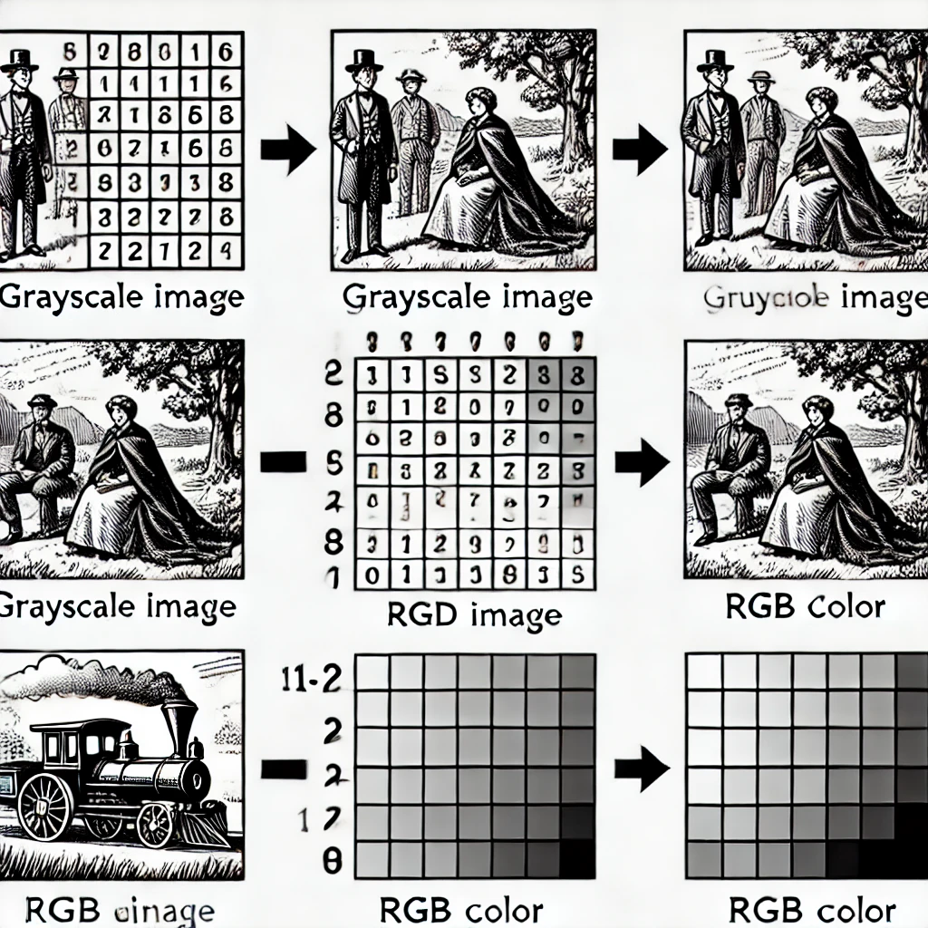
Representation of an Image as a 2D Matrix
Digital images are represented as 2D matrices of pixel values
Each pixel holds intensity (grayscale) or color information (RGB values)
Matrices are processed for tasks like edge detection, object recognition, etc

Slide 4
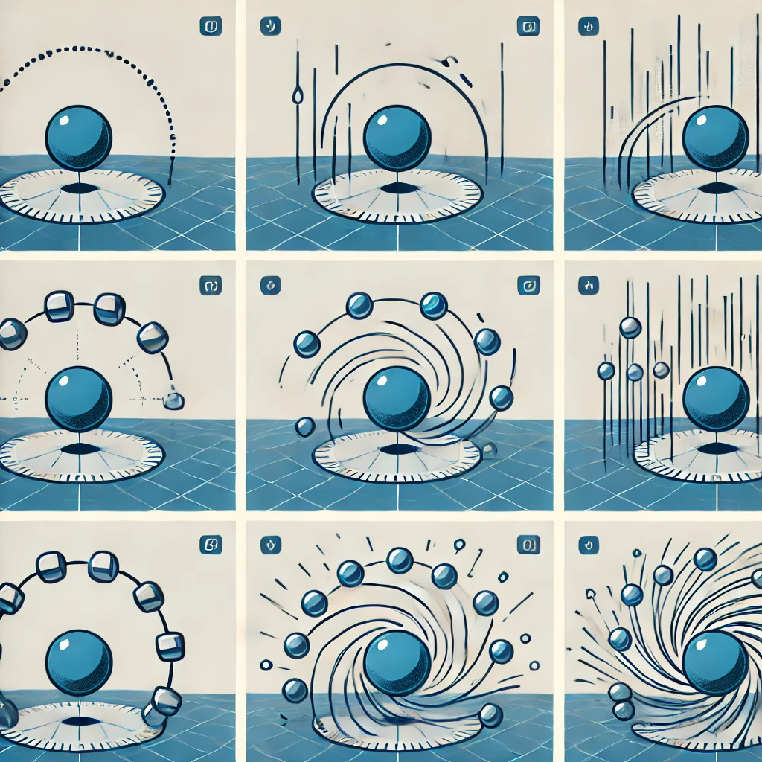
Videos as a Set of Image Frames
Videos are sequences of images (frames) displayed in rapid succession
Frame rate (FPS) affects the smoothness of motion
Each frame is an individual image processed during computer vision tasks like action recognition
Short sequence showing frames of a moving object

Slide 5
Introduction to Computer Vision and Its Applications
A field of AI enabling machines to interpret and process visual data (images and videos)
Applications : Face recognition
Object detection and tracking
Medical imaging (X-rays, MRI)
Autonomous vehicles
Industrial automation

Slide 6
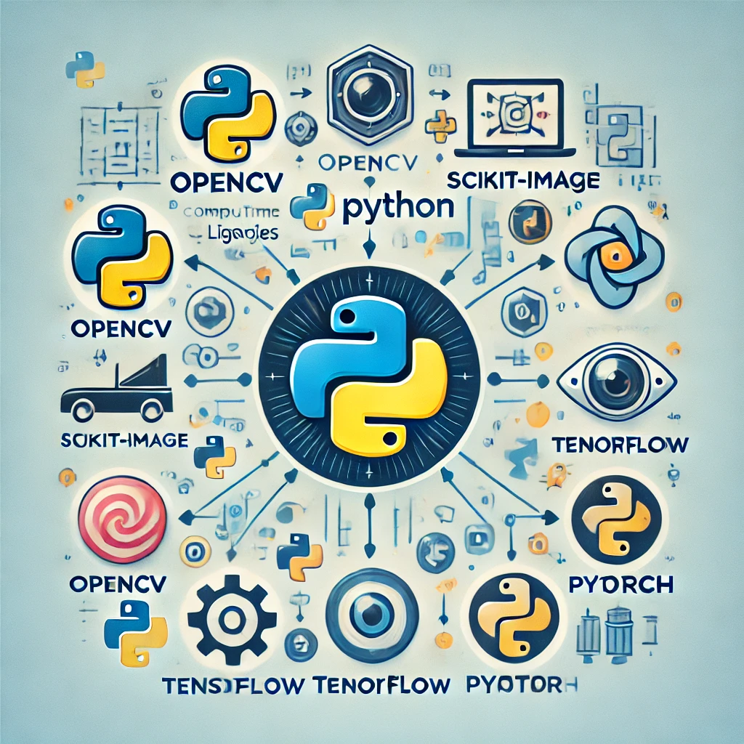
Overview of Python and Its Libraries for Computer Vision
Why Python for Computer Vision?
Easy to learn
Robust libraries,
Active community
Popular Libraries:
OpenCV: Real-time computer vision
scikit-image: Image processing in Python
TensorFlow and PyTorch (for deep learning applications)

Slide 7
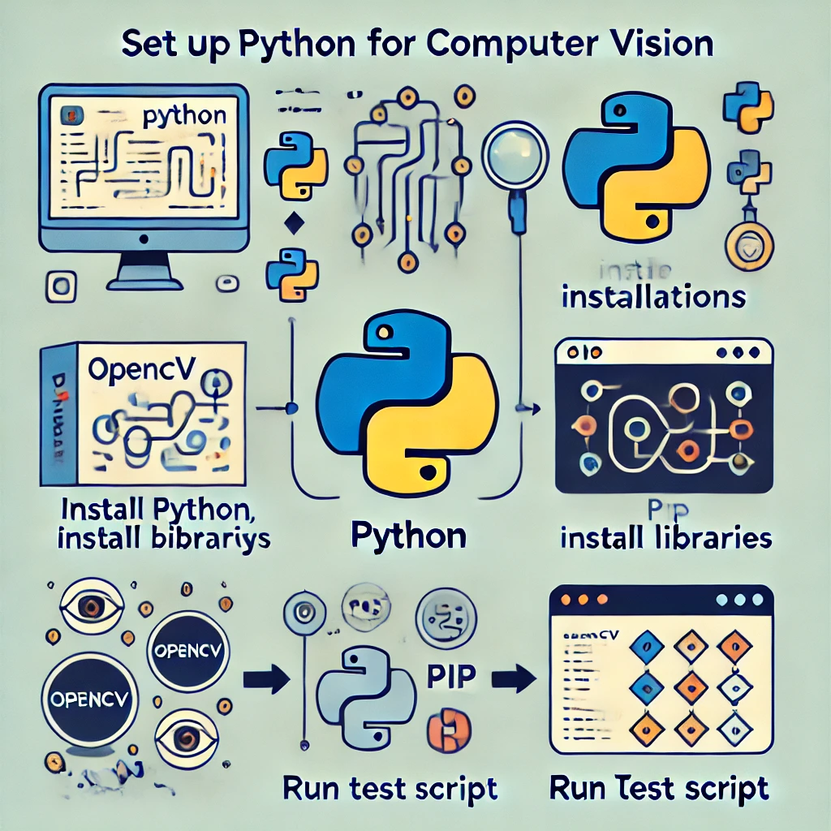
Setting Up Python and Necessary Libraries

